Slide 1
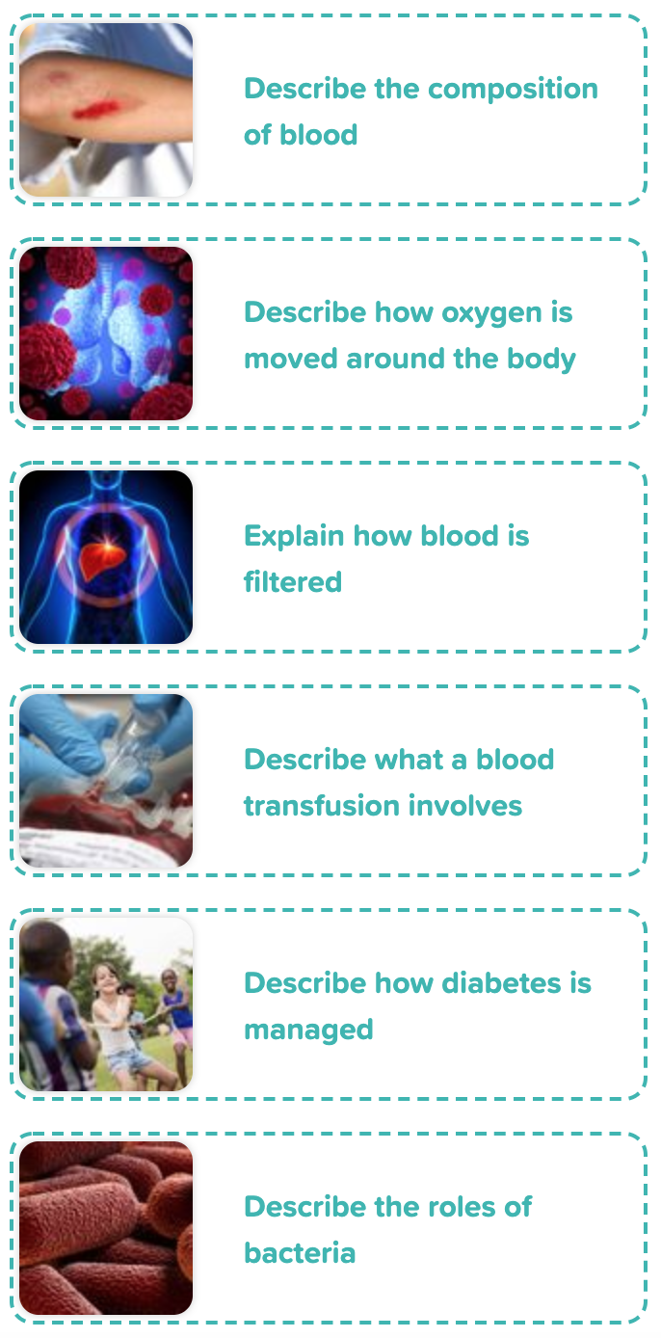
Year 6 Animals Including Humans
- Blood and Transportation
Scientific Enquiry Covered | Rocket Words Covered | Name of Task / Tasks | Resources Needed | National Curriculum Reference | Summative Quiz Questions
Reporting and presenting findings from enquiries. | red blood cell, platelet, haemoglobin, plasma, antibody | Research diseases which affect the composition of blood | Composition of Blood Handout, Research Materials - Books/Internet Modelling the Circulatory System, Clear tubing Water, Scissors, Tape, Red food colouring | Identify and name the main parts of the human circulatory system and describe the functions of the heart, blood vessels and blood. | About Select... of our blood is made from Select... This is a thin, pale Select... liquid which carries the formed elements. The formed elements describe the part of the blood which is made up of cells and cell fragments. _______ blood cells are the most abundant type of cell found in the blood. Choose 1 answer. Platelets are cell fragments that help our blood clot together in a process called __________. Choose 1 answer As soon as the white blood cells find something which shouldn’t be there, they attack it to protect us against illness and disease and other white blood cells rush over.
Reporting and presenting findings from enquiries, including conclusions, causal relationships and explanations of and degree of trust in results, in oral and written forms such as displays and other presentations. | trachea, bronchi, alveoli, capillary, diaphragm | Make a Model Lung. | Make a Model Lung Plastic bottles with bottoms cut off. Straws. Elastic bands. Scissors. Balloons (2 per bottle). Modelling clay Handout | Identify and name the main parts of the human circulatory system and explain the functions of the heart, blood vessels and blood; to describe the ways in which nutrients and water are transported within animals, including humans. | The respiratory and circulatory systems meet at the trachea. Choose 1 answer The respiratory and circulatory system meet in the Select... They contain tiny Select... and your Select... blood cells absorb the oxygen from the breath you took. It carries this oxygen to all the cells in your Select... The blood also picks up Select... as it travels around your body, which is no use to the body. Order the route air takes through your body. Drag the answers into the correct order When the diaphragm arches down, what happens? Choose 1 answer Which organ is responsible for your breathing? Choose 1 answer
Reporting and presenting, findings, including conclusions, casual relationships and explanations of and degree of trust in results, in oral and written forms such as displays and other presentations. | spleen, liver, filter, organ, microorganism | Creating a model of the liver or spleen. | Handout Modelling clay | Identify and name the main parts of the human circulatory system and describe the functions of the heart, blood vessels and blood. (Without a working liver your blood would not clot.) | Your red blood cells die at a rate of two million per day. One of the liver's job is to remove {{dead}} blood cells. It breaks them down and {{reuses}} what it can. The liver can put up with {{a lot of}} damage. Another {{cleansing}} organ is the spleen which helps to filter your blood and remove harmful {{wastes}}. It is located near the {{stomach}}. In a transplant, when a person is given half of a new liver, the other half will grow back! Which of these organs help to cleanse your body. Red blood cells last for about how long?
Finding out things using a wide range of secondary sources of information | transfusion, blood group, Karl Landsteiner, phlebotomist, patient | Produce a simple model that shows which blood groups can donate to one another and answer questions on blood | Blood Transfusion Model Handout | Identify and name the main parts of the human circulatory system and describe the functions of the heart, blood vessels, and blood | Donated blood has to be carefully matched as not all blood will suit all patients. {{Doctors}} had been trying to perform transfusions before Karl Landsteiner discovered that not everyone has the same {{type}} of blood. He noticed that when he mixed from two people, the {{cells}} would often clump together and {{clot}}. He concluded there were four different types of blood, called blood {{groups}}. Who collects blood samples from patients? Which of these are blood types? (Tick all that apply) What will a patient receive if they need more blood?
Report on findings from enquiries, including oral and written explanations, displays of results | pancreas, insulin, diabetes, type 1 diabetes, type 2 diabetes | Explore how diabetes effects peoples' lives. | Plan a Menu Reference books/computers with internet access. Diabetes Investigation - A Day in the Life Reference books/computers with internet access Handout | Recognise the impact of diet, exercise, drugs and lifestyle on the way their bodies function | A person with diabetes has too little sugar in their blood. Insulin is a hormone that is made in the {{pancreas}} and works like a key to a door. It allows the sugar to go from the {{bloodstream}} into the {{cells}}. Diabetes occurs when the sugar levels in the blood {{rise}}. This may be because there is not enough {{insulin}} or if the {{insulin}} can't open the door to the body cells, so no {{sugar}} can do through. Which of these foods contains sugar? Which type of diabetes do children usually have? What is sugar used by the body for?
Report on findings from enquiries, including oral and written explanations, displays of results | prokaryotes, microscope, bacteria, nucleus, probiotics | Psychedelic Milk. | Colour Changing Milk Experiment, Milk (whole, semi-skimmed, skimmed, cream) Dinner plates Food colouring in red, yellow, green, blue Washing up liquid Cotton wool buds Handout | Animals, including humans | Prokaryotes have no nucleus. Bacteria are found {{everywhere}} and are very {{useful}} to life. Some bacteria cause {{diseases}}, which can be treated using medicine. Cyanobacteria are prokaryotes but used to be called {{blue-green}} algae. They are the {{beginning}} of the food chain for many animals that live in water. They also produce {{oxygen}}. Which of these are bacteria shapes? What are prokaryotes also called? Where do prokaryotes get their food from?
Developing Experts Year 6 National Curriculum Map September 2021

Slide 2
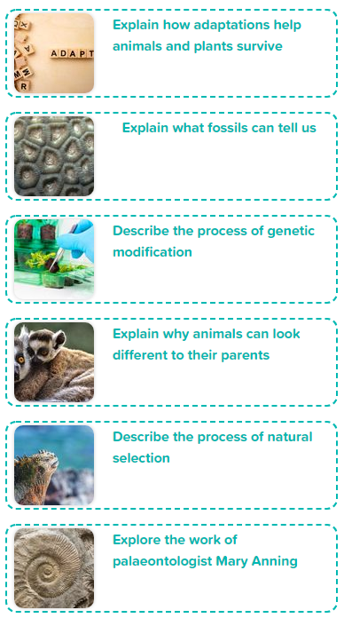
Year 6 Evolution and Inheritance
Scientific Enquiry Covered | Rocket Words Covered | Name of Task / Tasks | Resources Needed | National Curriculum Reference | Summative Quiz Questions
Identify scientific evidence that has been used to support or refute ideas or arguments | adaptation, desert, cactus, insulating, environment | Create your own animal that would be well adapted to survive in the desert. | Handout | Identify how animals and plants are adapted to suit their environment in different ways and that adaptation may lead to evolution | Which of these creatures would you expect to find in an arid desert? Which wouldn't you expect to find there? Cacti have developed {{spines}} in order to stop {{predators}} eating them and stealing their precious supply of {{water}}. This is a key {{adaptation}} that helps them survive in an arid desert. Some cacti can grow to up to 15 metres tall. Have another look at the expert film on scorpions and toads. What advantages do scorpions have as a result of their exoskeleton (hard shell-like skin)? Choose all that apply. Which of these challenges might a creature living in an arid desert expect to come across? (choose all that apply)
Identify scientific evidence that has been used to support or refute ideas or arguments | fossil, fossilisation, evidence, dinosaur, petrified | Review the handout and answer the questions. | Handout | Recognise that living things have changed over time and that fossils provide information about living things that inhabited the Earth millions of years ago. | Many plants and animals end up as fossils. Choose 1 answer Order these in the correct order to explain how a fossil is made. Drag the answers into the correct order Land animals are never fossilised. Choose 1 answer Sediment is made up of...? Tick all that apply. Choose 3 answers. What is a coprolite? Choose 1 answer
Identifying scientific evidence that has been used to support or refute ideas and arguments | genetically modified crops, toxin, resilience, breeding, yield | Hold a debate on GM crops. | Handout | Recognise that living things produce offspring of the same kind, but that offspring normally vary and are not identical to their parents. | No GM crops are grown commercially in the UK. Choose 1 answer. A GM crop is one that scientists have Select... - it has not Select... naturally. Scientists want to improve crops by changing their Select... to give them new characteristics. For example, they may take a gene that allows a crop to hold more water and put it into a plant that grows in a Select... climate. Which of these GM products are allowed to be imported to the UK? Drag the images into the correct area GM crops may cause harm to...? Choose 3 answers What does GM stand for? Choose 1 answer
Planning different types of scientific enquiries to answer questions, including recognising and controlling variables where necessary. | generation, species, evolution, offspring, DNA | Extract the DNA from a banana. | Extracting DNA from a Banana!, Goggles, Apron / Lab Coat, Banana, Sealable sandwich bag, Warm Water, Salt, Washing Up Liquid Filter Paper, Funnel, Rubbing Alcohol, Plastic containers | Recognise that living things produce offspring of the same kind, but normally offspring vary and are not identical to their parents. | Every living organism in the wild has to compete to live. Choose 1 answer. Which of these animals are extinct? Drag the images into the correct area Every offspring is Select... but it may share Select... from one or both of its parents. The parents and the young are from Select... generations. Animals with characteristics that are better adapted to survive in a habitat will survive but others, which aren't, will eventually die out or become Select... . What are an animal's offspring? Choose 1 answer Which characteristics do the cat species share? Choose 2 answers
Planning different types of scientific enquiries to answer questions, including recognising and controlling variables where necessary. | Charles Darwin, habitat, ancestor, Natural Selection, extinct | Camouflaged Worms. | Camouflaged worms - Individual model 20 plain toothpicks 20 toothpicks painted to match the floor/carpet, Stopwatch, Cups. Tweezers, Handout 1 | Identify how animals and plants are adapted to suit their environment in different ways, and that adaptation may lead to evolution, and find out more about how living things on Earth have changed over time, and find out about the work of palaeontologists such as Mary Anning, and about how Charles Darwin and Alfred Wallace developed their ideas on evolution. | The Darwin Medal was first awarded to Charles Darwin in 1890. On the Galapagos Islands in the Select... Ocean, he found lots of birds that looked like Select... .They were all very similar, expect for their Select... and had evolved from one, shared ancestor. He also noticed that the Select... were not all the same. They had Select... themselves to suit the Select... of the islands they were on. Order these events of Charles Darwin's life. Drag the answers into the correct order What was the ship called that Charles Darwin sailed to the Galapagos Islands on? Choose 1 answer A naturalist is someone who studies..? Tick all that apply. Choose 2 answers
Identify scientific evidence that has been used to support or refute ideas or arguments | Mary Anning, specimen, prehistoric, Jurassic Coast, palaeontologist | Create a fossil using simple materials! | Make Your Own Fossil Plasticine Plaster of Paris Water Mixing Dish/Bowl Cocktail sticks Handout - Page 1 | Find out about the work of palaeontologists such as Mary Anning; recognise that living things have changed over time and that fossils provide information about living things that inhabited the Earth millions of years ago. | The Jurassic Coast is a World Heritage Site. Choose 1 answer Mary Anning lived in Lyme Regis, Dorset, which had once been Select... It is called the Jurassic Coast because so many Select... ossils have been found there. She often went fossil hunting after Select... and would sell her findings to make money for her family. Mary Anning was a famous... Find 3 answers. Choose 3 answers. Mary Anning was the first person to discover which fossilised full skeleton? Choose 1 answer. What did Mary Anning use belemnites to create? Choose 1 answer
Developing Experts Year 6 National Curriculum Map September 2021

Slide 3
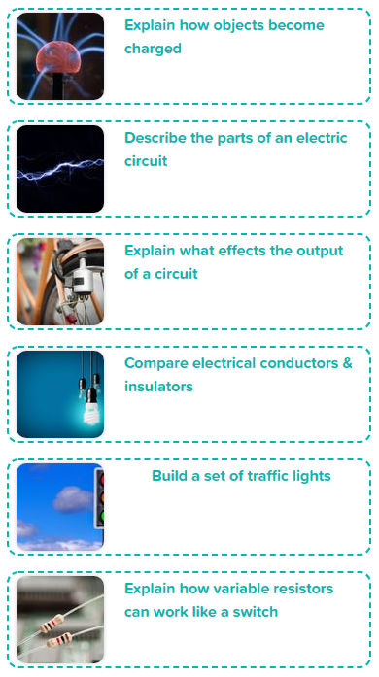
Year 6 Electricity
Scientific Enquiry Covered | Rocket Words Covered | Name of Task / Tasks | Resources Needed | National Curriculum Reference | Summative Quiz Questions
Recording data and results of increasing complexity using scientific diagrams and labels, classification keys tables, scatter graphs and / or bar and line graphs. | static electricity, charge, electric shock, friction, discharge | Explore ways of generating static electricity. | Comparing Static Generators Fabric cloth Balloon Plastic ruler Wooden ruler PVC pipe Aluminium cloth Shredded tissue paper Handout | Associate the brightness of a lamp or the volume of a buzzer with the number and voltage of cells used in the circuit; compare and give reasons for variations in how components function, including the brightness of bulbs, the loudness of buzzers and the on/off position of switches; use recognised symbols when representing a simple circuit in a diagram. | Organise these as to whether they are static electricity or powered electricity. Electrons are particles that orbit the nucleus of an atom. {{Friction}} creates a build up of electrical charge which is called {{static}} electricity. It is a flow of negatively charged {{electrons}}. What electrical charge do electrons have? What is static electricity caused by?
Recording data and results of increasing complexity using scientific diagrams and labels, classification keys tables, scatter graphs and / or bar and line graphs (over the two lessons). | circuit, battery, component, series circuit, switch | Building a circuit. | Circuit building 2x 3V bulbs 2x 1.5V cells 5 connecting wires Switch (optional) Handouts | Associate the brightness of a lamp or the volume of a buzzer with the number and voltage of cells used in the circuit; compare and give reasons for variations in how components function, including the brightness of bulbs, the loudness of buzzers and the on/off position of switches; use recognised symbols when representing a simple circuit in a diagram | Batteries have a positive and neutral pole. When the switch is turned {{on}}}, {{electrons}} can travel through a wire because the circuit is {{closed}}. They travel from the {{negative}} pole, around the circuit and back to the {{positive}} pole. In a bulb, the filament is a very fine wire, which {{resists}} the fast flow of {{electrons}}. This resistance turns the electricity into light! The brightness of a lamp increases as the voltage of cells used in the circuit increases. What is the very thin wire in a light bulb called? When electricity flows through a filament bulb, what is created? (Tick the correct answer.)
Recording data and results of increasing complexity using scientific diagrams and labels, classification keys tables, scatter graphs and / or bar and line graphs (Over the two lessons) | voltage, output, bulb, power, wind-up torch | Write a report which explains the importance of generating a light source in different situations, using the following headings: Emergency Power, Convenient Power and Outdoor Power. | Generating Power Lined paper A2 paper Marker pens Handout | Associate the brightness of a lamp or the volume of a buzzer with the number and voltage of cells used in the circuit; compare and give reasons for variations in how components function, including the brightness of bulbs, the loudness of buzzers and the on/off position of switches; use recognised symbols when representing a simple circuit in a diagram | The {{amount}} of light the bulb {{emits}} will not change as long as nothing else in the {{circuit}} changes. A ________ torch works by using the energy that the winder puts into the torch when they turn the handle, and use that energy to light the bulb. It takes about {{30 seconds}} to wind up a torch so it will give five minutes of steady, bright light. Whilst you are winding you will see the light getting {{gradually}} brighter, until it reaches its full level of {{brightness}}. Sort the torches into the right bucket. Wind up torches are handy because....
Plan different types of scientific enquiries to answer questions, recognise control variables where necessary | insulator, conductor, copper, short circuit, fuse | Exploring electrical conductors and insulators. | Dough Circuits Conductive and Insulating dough (instructions in Handout) LED lights Battery packs Handout | Pupils might work scientifically by: systematically identifying the effect of changing one component at a time in a circuit; designing and making a set of traffic lights, a burglar alarm or some other useful circuit. | Cables are made of both conducting and insulating material. The wire inside the cable must be made from a {{conductor}} but the outside must be made from an {{insulator}}. This stop you from getting an electric {{shock}}. A {{fuse}} is a tiny ceramic tube surrounding a thin metal strip. A short circuit is a connection on an electric circuit that allows a current to follow an {{unplanned}} path. Which of these conduct electricity and which are insulators? How does electricity flow through insulators? Which of these are important electrical safety measures? (Tick 3 boxes)
Plan different types of scientific enquiries to answer questions, including recognising and controlling variables where necessary | signal, timer-based, synchronised, receiver, sensor | Apply your knowledge about electricity. Design and make your own traffic lights circuit. | stiff card connecting wires crocodile clips 1.5V LEDs - caution as higher voltages may break the LEDs, test you LEDs before giving them to children. 2x 1.5V batteries paperclips drawing pins split pins Teacher guidance sheet Handout | Designing and making a set of traffic lights, a burglar alarm or some other useful circuit. | Emergency vehicles are able to change some traffic lights in order to save time. What is the sequence a traffic light shows? (Start with when the driver is stopped). All traffic lights have the same amount of time between signal changes. Some traffic lights work based on detectors - where are these located? (Tick 2 answers) Which colours of the traffic light are lit up to tell the driver to get ready to move?
Take measurements, use a range of scientific equipment, with increasing accuracy and precision and take repeat readings | dimmer switch, LED, adjust, variable resistor, resistor | Investigate how increasing the number of components in a circuit will change the voltage which flows through it. Construct a circuit with a single 1.5v cell, switch and buzzer, and then increase the number of buzzers and record what happens. | Resistance is Futile 1.5V cell x 3 per group of 3 pupils LEDs Bulbs Buzzers Breadboard Wire Wire strippers Variable resistor | Compare and give reasons for variations in how components function, including the brightness of bulbs, the loudness of buzzers and the on/off position of switches | If you remove a resistor from a circuit with a light, the circuit is incomplete so the light will turn off. Image bucket A resistor is an electrical {{component}}, which {{resists}} the flow of the current. In a circuit, it controls the amount of current going through the {{wire}}. Some can control only a fix amount of current but other can act like a dial switch. These are called {{variable}} resistors. What is the function of a resistor? On a resistor, what indicates the resistor's value?
Developing Experts Year 6 National Curriculum Map September 2021

Slide 4
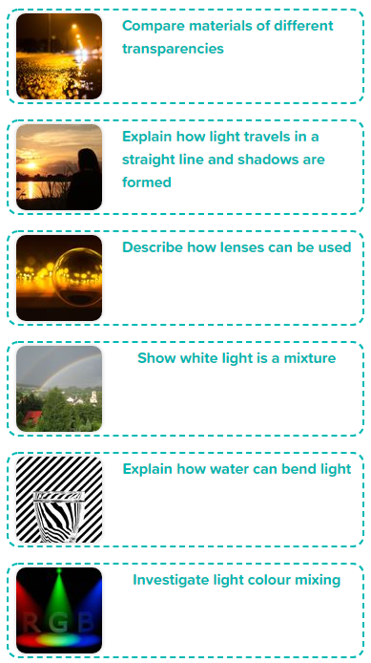
Year 6 Light
Scientific Enquiry Covered | Rocket Words Covered | Name of Task / Tasks | Resources Needed | National Curriculum Reference | Summative Quiz Questions
Identifying evidence that has been used to support or refute ideas or arguments | luminous, non-luminous, light source, transparent, opaque | Design and build your own lamp. | scissors tape/ masking tape coloured filters/ coloured sweet papers acetate/ cling film paper (coloured optional) card (coloured optional) tracing paper torch/ circuit building kit | Recognise that light appears to travel in straight lines | Which of these are natural light sources and which are artificial light sources? Light can only travel in straight lines. Light enters your eye through the {{cornea}}, which is the eye's first layer. It next goes through the {{pupil}}. This is the dark opening in the {{centre}} of your eye. It is in the middle of the coloured part, which is called the {{iris}}. Which of these reflect light? (Tick 3 boxes) Fill in the blank - If something is_________, light can not travel through it.
Taking measurements, using a range of scientific equipment, with increasing accuracy and precision, taking repeat readings when appropriate | shadow, opposite, obstruct, light ray, fluorescent | Investigate how distance from a light source affects the size of a shadow. | Casting Shadows Acetate with 1x1cm square 1m Ruler & 30cm ruler Light Source (i.e. a torch) Clamp Stand - Optional | Use the idea that light travels in straight lines to explain why shadows have the same shape as the objects that cast them | Light is a form of energy. Fill out the blanks Light travels in {{straight lines}}. A {{photon}} is the basic unit that light is made from. They travel together in {{narrow}} beams called {{rays}}. Light continues to travel until it is {{blocked}} by an object. Which of these are sources of light? Fluorescent lights are often bright. The path of the light is blocked by what?
Noticing patterns | focal point, lens, refraction, refracting telescope, convex lens | Build a refracting telescope. | Build a Refracting Telescope 2 x magnifying lenses metre stick/ piece of wood modelling clay/ sticky tack ruler set square Handout | Recognise that light appears to travel in straight lines; use the idea that light travels in straight lines to explain that objects are seen because they give out or reflect light into the eye; explain that we see things because light travels from light sources to our eyes or from light sources to objects and then to our eyes | Light moves faster through water than through air. On an extremely {{hot}} day, you can see heat haze. This is when some {{air}} get hotter that the rest and changes the {{speed}} of light. Light {{rays}} get bent as they pass through the heat and things beyond the haze look {{distorted}}. Which of these can you see light through? (Tick 2 boxes) When light rays pass from one transparent medium to another, they appear to change direction. What is this called? When an object is placed in water, how will it appear?
Predict the effects of colour mixing | spectrum, indigo, glass prism, mist, white light | Build a Newton's Colour Wheel. Write a statement which explains why the colours seem to disappear. | Handout a simple series circuit with two 1.5V batteries, wires and a motor card scissors glue colouring pens/pencils (optional) | Explain that we see things because light travels from light sources to our eyes or from light sources to objects and then to our eyes | Light that comes from the Sun is white light. This is made up of all the colours in the rainbow. Order the colours of the spectrum - start with the colour that bends the least and finish with the colour that bends the most. When light passes through a prism, it is {{refracted}}. The rays of each colour bend {{differently}} so we can see all the colours that make up the {{white}} light. {{Red}} bents the least and {{violet}} bends the most. Which of these objects will refract light? What happens to the speed of light when it passes through a glass prism?
Planning different types of scientific enquiries to answer questions, including recognising and controlling variables where necessary | medium, magnify, rainbow, apparent, distorted | Observe how a glass of water can be used as a lens. | Glass of water lens cylindrical glass of water drawing of an arrow Droplet Magnifier small piece of waterproof transparent material i.e. cling film, acetate, clear acrylic, petri dish etc. pipette water | Use the idea that light travels in straight lines to explain that objects are seen because they give out or reflect light into the eye; explain that we see things because light travels from light sources to our eyes or from light sources to objects and then to our eyes; use the idea that light travels in straight lines to explain why shadows have the same shape as the objects that cast them | Water acts as a lens but things look distorted when you look at them through water. Lenses can only make things look bigger. A lens is a {{curved}} piece of {{transparent}} material. The curve makes the light rays change {{course}}. When you hold a magnifying glass to a book, the light rays coming from the {{book}} have travelled through the {{lens}} and appear {{larger}} to your eyes. Lenses in which of these helps us to see tiny things close up - things we can't even see with our naked eye? Lenses in which of these helps us to see things very far away, in Outer Space?
Planning different types of scientific enquiries to answer questions, including recognising and controlling variables where necessary. | primary colours, secondary colour, light filter, magenta, cyan | Investigating coloured objects under coloured lights. | Colour Mixing Green, blue, red filters Torches Red, blue, yellow, green, and white paper Handout | Exploring the way that light behaves, including light sources, reflection and shadows. | When mixing paint colours, the {{more}} paint you add, the darker the combined colour gets. This is because more {{light}} is being absorbed. Orange, purple and green are {{secondary}} colours and the shade will depend on the ratio of colours used. The thicker the mixture of paint, the more {{opaque}} the paint becomes. Red, blue and yellow lights are used in electronic lights. What are the primary colours of light? Which of these colours are used in a colour printer? (Tick all that apply) If red and green light are shined at the same spot of a piece of paper, what colour shows?
Developing Experts Year 6 National Curriculum Map September 2021

Slide 5
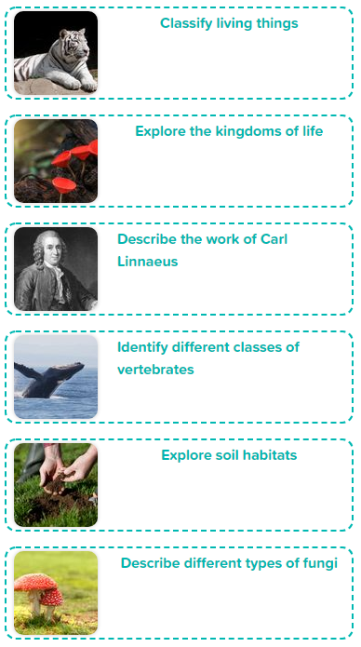
Year 6 Living Things and their
Habitats
Scientific Enquiry Covered | Rocket Words Covered | Name of Task / Tasks | Resources Needed | National Curriculum Reference | Summative Quiz Questions
Recording data and results of increasing complexity using scientific diagrams and labels, classification keys , tables, scatter graphs, and bar and line graphs. | classify, spore, micro-organism, seed, similarities | Create your own classification key and challenge your friends! | Create a Classification Key Paper Pens Pencils Books/Internet for research | Describe how living things are classified into board groups according to common observable characteristics and based on similarities and differences, including micro-organisms, plants and animals. | All animals are given a genus and species name. Drag the images into the correct area. In which country was Carl Linnaeus born? Which language is used when allocating a scientific name to an animal? In which year was Carl Linnaeus born?
Planning different types of enquiries to answer questions including recognising and controlling variables where necessary | multicellular, unicellular, kingdom, cell, MRS GREN | Have a go at growing your own fungi! | Mould Growing Investigation Slices of bread Sealable sandwich bags Water Sticky labels Marker pens Handout | Describe how living things are classified into broad groups according to common observable characteristics and based on similarities and differences, including micro-organisms, plants and animals. Give reasons for classifying plants and animals based on specific characteristics. | Under a microscope, scientists discovered new organisms that needed a new classification as they were neither plants nor animals. Scientists have classified living things into Select...groups called Select...based on different Select...One of these features is how an organism gets its Select... Select... make their own Select... but Select... do not. Select...can usually move themselves around, whilst Select... cannot. Sort these by whether they are a kingdom or not. What were the first two kingdoms scientists agreed on? Which food source is incredibly important in the ocean?
Identifying scientific evidence that has been used to support or refute ideas or arguments | Latin, genus, Carl Linnaeus, class, species | Research the different kingdoms of life | Classification Challenge Handout Pens Paper Scissors Books / Internet (research) | Describe how living things are classified into broad groups according to common observable characteristics and based on similarities and differences, including micro-organisms, plants and animals, find out about the significance of the work of scientists such as Carl Linnaeus, a pioneer of classification. | Linnaeus's system for classification is rarely used today. Linnaeus gave Select... names to the species he identified. The Select...name was more general. Homo sapiens is the Select... word for human beings; Select... means human beings and Select... means wise. What do botanists study? Which of these species belong to the Felis genus? (Tick all that apply) Carl Linnaeus published a book called Systema Naturae. What does this mean?
Reporting and presenting findings from enquiries, including conclusions, casual relationships and explanations of and degree of trust in results, in oral and written forms such as displays or other presentations, identifying scientific evidence that has been used to support or refute ideas | vertebrate, cold-blooded, amphibian, reptile, mammal | Create a hanging mobile display that gives key information about the five different classes of vertebrates. | Classifying Animals Reference books/internet Scissors Glue Handout | Describe how living things are classified into broad groups according to common observable characteristics and based on similarities and differences, including micro-organisms, plants and animals, classify animals into commonly found invertebrates (such as insects, spiders, snails, worms) and vertebrates (fish, amphibians, reptiles, birds and mammals). | Animals are classified at birds if they can fly and build nests. Which of these animals are warm-blooded and which are cold-blooded? Which of these are vertebrates? (Tick all that apply) Why are whales classified as mammals and not fish? (Tick all that apply) What does the word amphibian mean?
Grouping and classifying. | carbon dioxide, microorganism, plant, oxygen, microscopic | Research different organisms which live in soil. | Handout Books / internet Poster paper Pens, pencils, crayons etc. Handout - Mission to Write! The Best Soil! | Describe how living things are classified into broad groups according to common observable characteristics and based on similarities and differences, including micro-organisms, plants and animals. Use the local environment throughout the year to explore and answer questions about animals in their habitat. | Life above the ground relies on life below ground. Soil is a Select... for many living organisms. The weather affects which type of plants and animal live in a particular soil, because of differences in Select... and how much Select... here is. Billions of Select... live in the soil and they are very important to the health of the planet. What does soil provide for a seed when it is growing? What fraction of all living things use soil as their habitat? Which of these organisms are found in soil? Tick all that apply
Record scientific data using diagrams | mycelium, fungi, mushrooms, yeasts, hyphae | Observe how spore prints change appearance on paper depending on their distance from it. | Handout Large mushrooms Clamp stands Clamps String Skewer to make hole Plain paper Hairspray Ruler | Describe how living things are classified into broad groups according to common observable characteristics and based on similarities and differences, including micro-organisms, plants and animals | What is the fungal cell wall made from? What is the scientific term for a 'mushroom’? From the top to the bottom, arrange the parts of the fungus in order. From the top to the bottom, arrange the parts of the fungus in order. Which of the following are types of fungi? Fungi are not plants. They belong to their own Select... of organisms. Fungi obtain nutrients by breaking down dead and decaying matter, whereas plants obtain nutrients via Select... . Fungal cells are called Select... , and a group of these come together to form the Select... . Fungi can reproduce asexually by producing Select... , or sexually by merging cells from two fungi together.
Developing Experts Year 6 National Curriculum Map September 2021

Slide 6
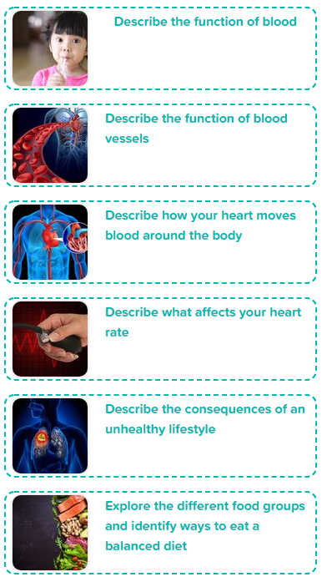
Year 6 Animals Including Humans
- The Heart and Health
Scientific Enquiry Covered | Rocket Words Covered | Name of Task / Tasks | Resources Needed | National Curriculum Reference | Summative Quiz Questions
Identify scientific evidence that has been used to support or refute ideas or arguments | transportation, cell, nutrients, protein, circulatory system | Model cell movement using gummy bears! | Gummy Sweet Osmosis Gummy sweets Beakers/ cups/ glasses Milk Tap water Salt Water Cola/soda Rulers Handout | Describe the ways in which nutrients and water are transported within animals, including humans | Capillaries transport nutrients, oxygen and waste products. Nutrients travel through the capillaries, which are tiny blood Select... , until they reach a cell that needs them. Select... has many important functions and makes up Select... of our bodies. It enters the red blood cells by a process called Select... . Which of these make up the circulatory system? (Tick all that apply) What does protein help your muscles do? What do enzymes extract from carbohydrates?
Record data and results of increasing complexity using scientific diagrams | blood vessels, heart attack, artery, fatty deposits, vein | Investigate blood clotting! | Four equally sized disposable cups Pin Ruler Stopwatch | Identify and name the main parts of the human circulatory system, and describe the functions of the heart, blood vessels and blood. | People have always known that the heart pumps blood in a circuit through the body. Exercising makes your heart muscle Select... and can help you live longer. Eating Select... is another key to a healthy heart. When you eat Select... fat than your body can use, it may build up as fatty deposits inside your blood vessels. These deposits can cause blood Select... . All fats that you are eat are bad for you. Doctors were watching blood flow in the tail of which live animal, when they realised Harvey was right? What invention was used to investigate William Harvey's claim that the heart was at the centre of a blood circulating system?
Plan different types of scientific enquiries to answer questions | involuntary, contract, relax, oxygenated, bloodstream | Create a model of the heart. | Modelling the Heart Plastic bottles with wide neck Water Balloons Skewer or pencils Straws Sticky tape Handout | Identify and name the main parts of the human circulatory system, and describe the functions of the heart, blood vessels and blood. | The aorta is the biggest vessel of all. Your heart is a powerful Select... . Every time it Select... , it pumps blood to all parts of your Select... . When you exercise, your heart beats Select... because it is having to work harder. Order the journey of blood. Drag the answers into the correct order. The heart is divided into how many chambers? Choose 1 answer Which of these are part of your circulatory system? Tick all that apply. Choose 2 answers
Reporting and presenting. | blood pressure, general practitioner, pulse, heart rate, exercise | Check your heart rate when resting and after exercise. Draw a bar graph to show your results! | Beating Pulses Stopwatch Pen Handout 1 - Beating Pulses | Identify and name the main parts of the human circulatory system, and describe the functions of the heart, blood vessels and blood | Everyone's heart rate is 90 pulses per minute. Choose 1 answer Your Select... is how often your heart squeezes to pump blood around the body. Your Select... is the pushing force caused by heart pumping the blood through the body. When you exercise heart rate Select... because your cells are using lots more Select... .Having high blood pressure (hypertension) can result in which of these medical conditions? Choose 2 answers Blood pressure is of one the things that nurses and GPs check to make sure which system is working properly? Choose 1 answer _______ walls are very thin so oxygen and nutrients can easily pass through. Choose 1 answer
Reporting and presenting findings from enquiries, including conclusions, casual relationships and explanations of and degree of trust in results, in oral and written forms such as displays and other presentations. | addiction, black tar, cigarette, lung cancer, poison | Create an anti-smoking campaign! | Anti-Smoking Campaign Handouts Paper / pens / craft materials | Recognise the impact of diet, exercise, drugs and lifestyle on the way bodies function. | Smoking cigarettes is one of the worst things you can do to your lungs and heart. Choose 1 answer Cigarette smoke also contains sticky, black Select... , which builds up on the smoker's lungs. The Select... can become so stiff that they cannot expand and pass Select... to the blood. When smokers exercise, they run out of Select... and their heart pumps harder. Select... oxygen actually reaches their cells through. Cigarette smoke only affects the smoker's lungs. Roughly how many different chemicals enter the lungs when a person inhales cigarette smoke? Cigarettes smoking contain which of the following? (Tick all that apply)
Identify scientific evidence that has been used to support or refute ideas or arguments. | nutrients, carbohydrates, balanced diet, vitamins and minerals, protein | Investigate what type of taster you are. | Student Handouts Natural, blue food dye Cotton buds Card Hole-punch Paper towels Mini cups Drinking water Magnifying glass | Recognise the impact of diet, exercise, drugs and lifestyle on the way their bodies function Describe the ways in which nutrients and water are transported within animals, including humans | It is important to eat an equal amount of each of the food groups. Order the food groups from the smallest to the largest amount needed for a balanced diet. Drag the answers into the correct order Select...provides our body with energy. Fruit and vegetables contain Select... and minerals which are essential for our body to function well. Protein is needed for Select...and you must also make sure you drink enough Select... What does meat provide us with? Choose 1 answer Which of the following are carbohydrates? Choose 2 answers
Developing Experts Year 6 National Curriculum Map September 2021

